Slide 1
Learning Big Data
Aditya Konda
Big Data Engineer

Slide 2
Content
Relational Database Management Systems vs Data Warehouse
OLTP and OLAP Architecture
Big Data
3v’s of Big Data
Implementation of Big Data
Big Data Technologies
Big Data Tools
Descriptive analytics on Big Data Architecture
Advantages of using Big Data Technologies.

Slide 3
RDBMS vs Data-Warehouse
RDBMS
Data warehouse
OLTP (On Line Transaction Processing)
Normalized
Current Data
Space requirement relatively small
Example: 1 years of data
Uses: daily operational business activities
OLAP (On Line Analytic Processing)
De-normalized
Current and Historical Data
Space requirement is large
Example: 5 to 30 years of data
Uses: Analysis and decision Making

Slide 4
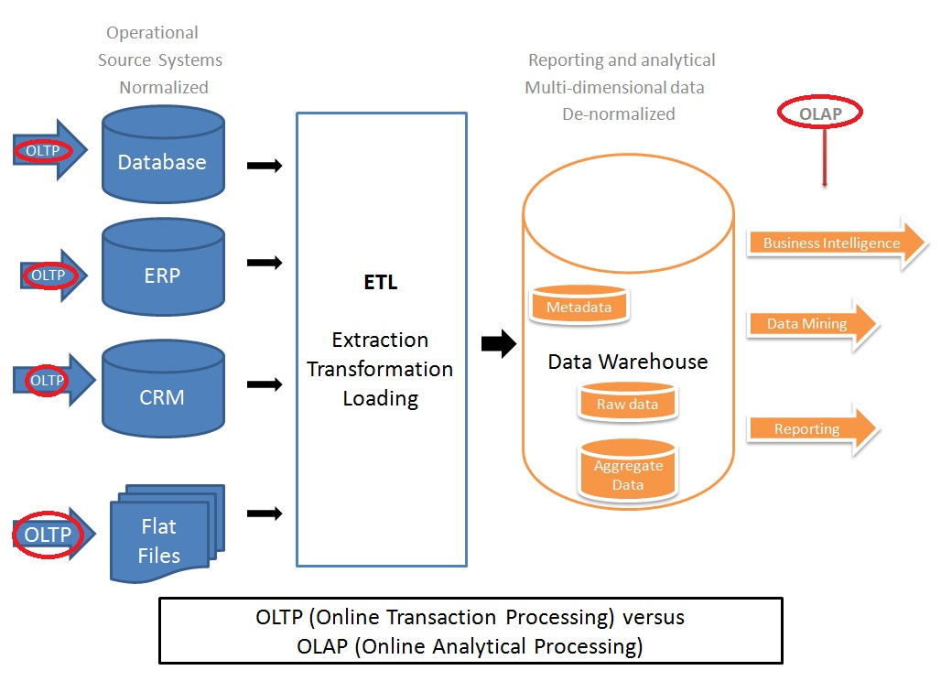

Slide 5
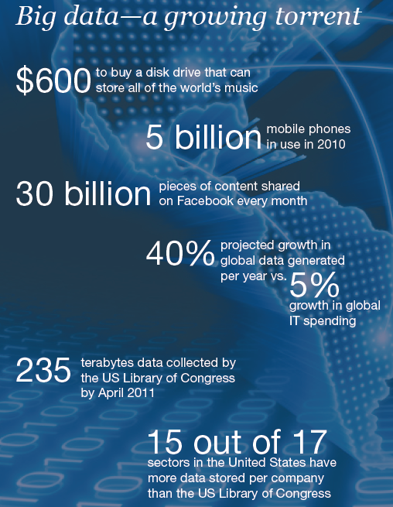
Big Data
IBM claims 90% of today’s stored data was generated in just the last two years.
Facebook generates 10 TB daily
Twitter generates 7 TB of data daily
Walmart handles more than 1 million customer transactions every hour.

Slide 6
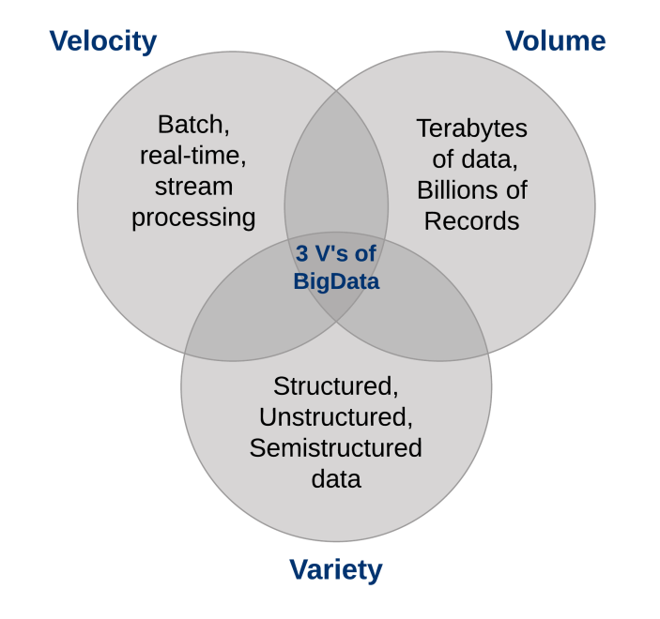
3 v’s of Big Data
Volume
Velocity
Variety

Slide 7



Implementation Big Data
Activity Data
Photos and video image data
Sensor Data
IoT (Internet of Things)

Slide 8






Big Data Technologies

Slide 9
Big Data Tools
Where processing is host?
Distributed Servers / Cloud
Where Data is Stored?
Distributed System. (HDFS)
Programming Model Used
Map Reduce, Spark
Data is stored and indexed
Solr, Elasticsearch.
Operation performed on data
Descriptive analytic and Predictive Analytics

Slide 10
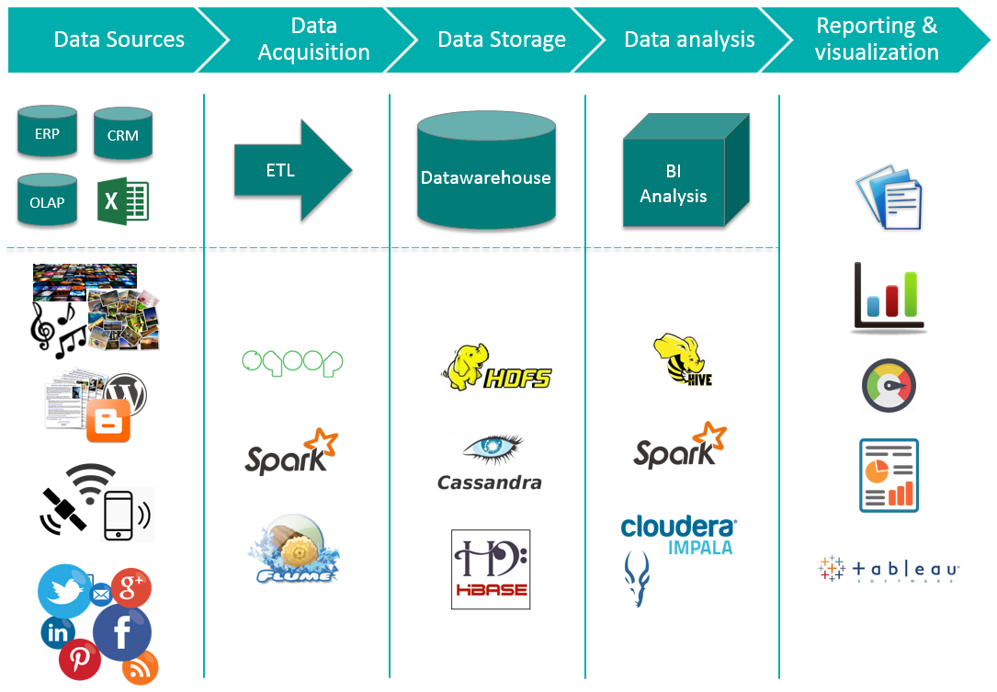
Descriptive Analytics using Big Data

Slide 11
Advantages of using Big Data Technologies
Cheap commodity hardware
Distributed Architecture
Open Source
Integrate different tools

Slide 12


